Slide 1





WELCOME TO G1 PRESENTATION
CLASS BH-AF-2005-2.3
NGO THI MAI LOAN

Slide 2
CONTENTS
MINH
BUBBLE SORT
NHAT
SELECTION SORT
G1
HOANG
QUICK SORT
HUNG
INSERTION SORT

Slide 3
PREVIOUS PRESENTATION
Algorithm Analysis
Asymptotic Analysis
How Does Asymptotic Analysis Work
Asymptotic Notations

Slide 4
BUBBLE SORT
MINH
THE IDEA OF THE BUBBLE SORT ALGORITHM
The bubble sort algorithm now sorts the sequence of numbers by repeating the task of swapping two consecutive numbers if they are in the wrong order (the latter is less than the former in the case of ascending sort) until the sequence is sorted numbers.

Slide 5
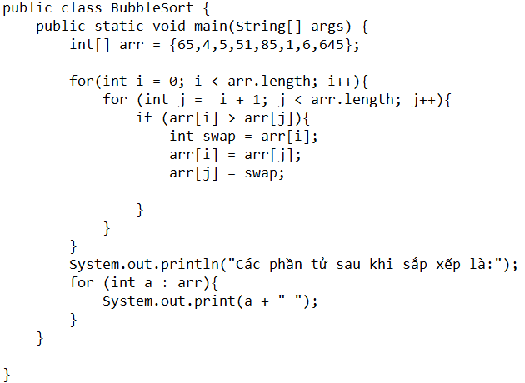
MINH
HOW DOES IT WORKS?
The bubble type is a type of internal exchange. It is considered one of the simplest methods to sort an array of objects. It is also known as sink sort (because the smallest items "sink" to the bottom of the array).
Instead of searching an entire array, bubble sort works by comparing pairs of adjacent objects in the array. If the objects are not in the correct order, they are swapped so that the largest of the two moves upwards. This process continues until the largest of the objects, eventually "bubbles" up to the highest position in the array. After this happens, the search for the next largest object begins. The swap continues until the entire array is in the correct order.

Slide 6
Summary
MINH
Bubble Sort is a simple sorting algorithm. This sorting algorithm is performed based on comparing pairs of adjacent elements and swapping the order if they are out of orders. This algorithm is not suitable for use with large data sets where the average and worst case complexity is Ο(n2) where n is the number of elements.The bubble sort algorithm is the slowest among the basic sorting algorithms. This algorithm is even slower than the direct swap algorithm although the number of comparisons is the same, but because two adjacent elements are swapped, the number of swaps is more.

Slide 7
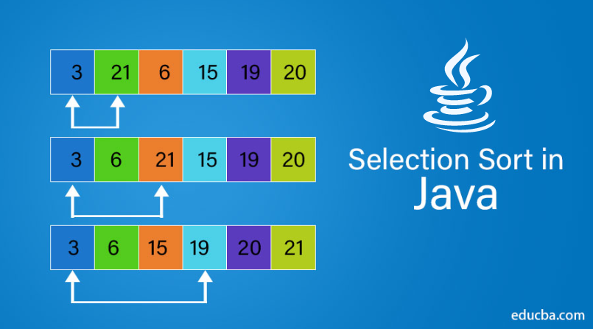
SELECTION SORT
NHAT
Introduction to the Selection Sort algorithm.
How Selection Sort works
CODE DEMO
Evaluation of the time efficiency of selection sorting and interpretation
1
2
3
4

Slide 8
1. Introduction to the Selection Sort algorithm.
NHAT
Selection sort is a simple algorithm. This sorting algorithm is an algorithm based on the in-place comparison, where the list is divided into two parts, the sorted list on the left and the unsorted list on the left. right. Initially, the sorted part is empty, and the unsorted part is the entire original list.
The smallest element is selected from the unsorted array and swapped with the leftmost element and that element becomes the element of the sorted array. This process continues until all the elements in the unsorted array have been moved to the sorted array.
This algorithm is not suitable for large data sets where the worst-case and average-case complexity is O(n2) where n is the number of elements.

Slide 9
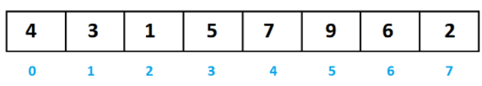
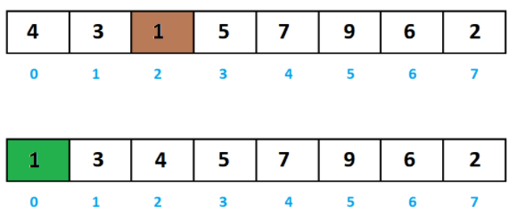
2. How Selection Sort works
NHAT
For example, the problem of sorting the sequence a into a non-decreasing sequence with:
a = [4, 3, 1, 5, 7, 9, 6, 2]
For illustration we will use the blue elements to indicate the elements have been arranged in the correct position. The brown element indicates the smallest element in the remaining segment.Initially, we will initialize the subsequence with a[0], of course with the one-element subsequence, it is sorted.We start from the element with index 0 to n-1.First we find the smallest element in the range from 0 to 7. Then swap for element a[0].

Slide 10
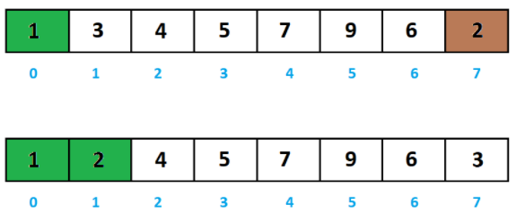
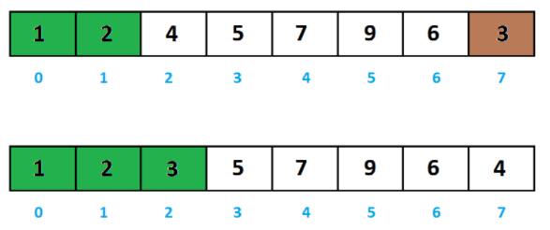
NHAT
Next find the smallest element in the range from 1 to 7. Then swap for element a[1].
Next find the smallest element in the range from 2 to 7. Then swap for element a[2].

Slide 11
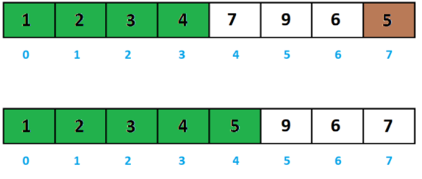
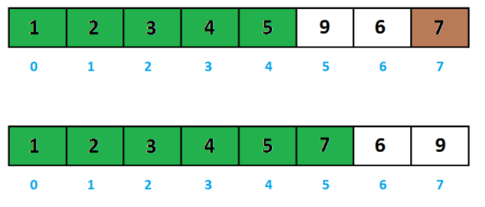
NHAT
Next find the smallest element in the range between 4 and 7. Then swap for element a[4].
Next find the smallest element in the range between 5 and 7. Then swap for element a[5].

Slide 12
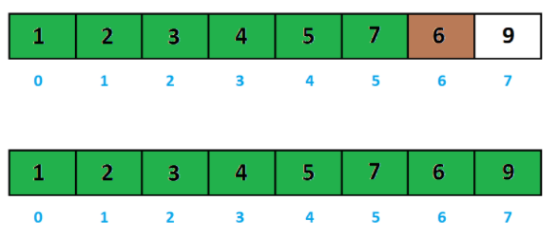
NHAT
Next find the smallest element in the range from 6 to 7. Then swap for element a[6].
The last 1 element is definitely in the right position.

Slide 13
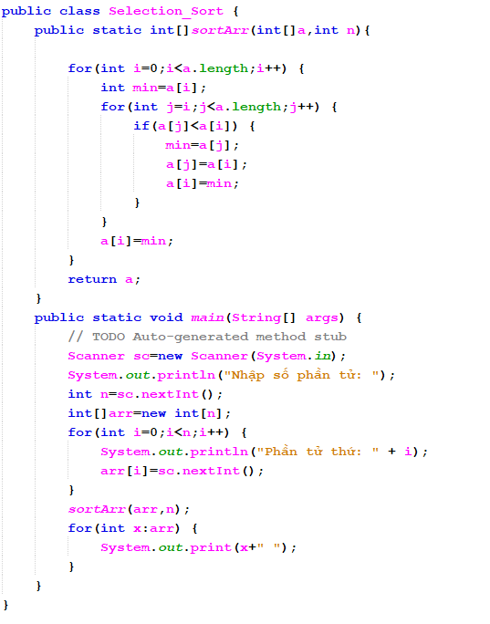
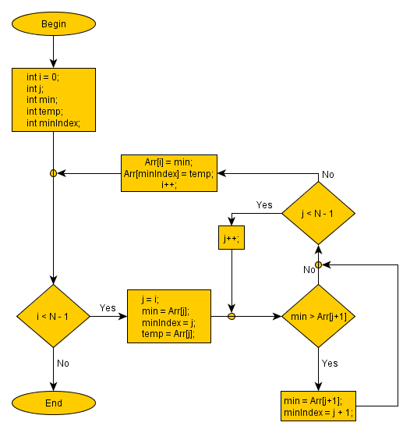
3. CODE DEMO
NHAT

Slide 14
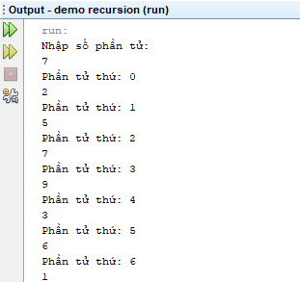

NHAT

Slide 15
4. Evaluation of the time efficiency of selection sorting and interpretation
NHAT
Complex time and space:
To sort an array using Selection Sort, you must iterate through the array once for every value you have in the array.
If we have n values in our array, the Selection Sort has a time complexity of O(n²) in the worst case. In the best case, we already have a sorted array but we need to look through the array O(n²) times to be sure! Therefore, the best and worst case time complexity of Selection is the same.
What about space complexity? Selection Sort sorts in-place, meaning we don't need to allocate any memory for the sort to happen. The space complexity is O(1).

Slide 16
NHAT
Performance of O(n) selection type:
Best: no swap, n^2
Worst: n - 1 swap, n^2/2 comparisons
Medium case: compare O(n) displacement and n^2/2
Advantage: The algorithm runs faster when the array is partially sorted
Disadvantage: Performance is not high

Slide 17
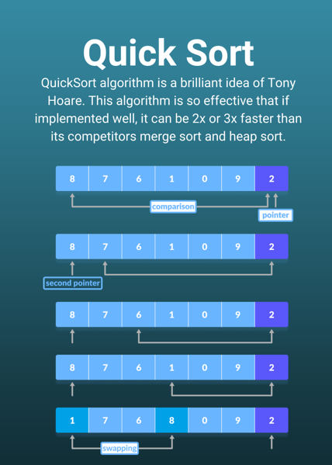
QUICK SORT
HOANG
Quick Sort is one of the different Sorting Techniques which is based on the concept of Divide and Conquer, just like merge sort. But in quicksort, all the heavy lifting(major work) is done while dividing the array into subarrays, while in the case of merge sort, all the real work happens during merging the subarrays. In the case of quicksort, the combined step does absolutely nothing.
It is also called partition-exchange sort. This algorithm divides the list into three main parts
Elements less than the Pivot element
Pivot element(Central element)
Elements greater than the pivot element
Notes:
Divide and Conquer: The idea of this method is quite simple and easy to understand: When we need to solve a problem, we will proceed to divide that problem into smaller problems. Continue dividing until this subproblem is no longer divisible, then we solve the smallest problem and finally combine the solutions of all the subproblems to find the solution of the original problem.

Slide 18
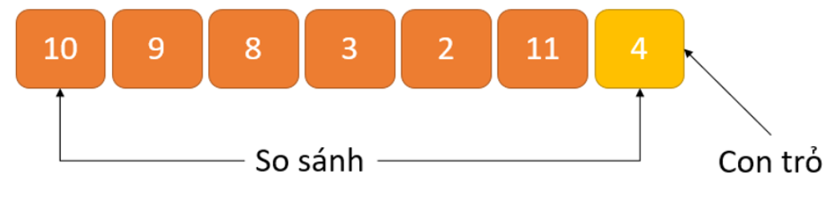
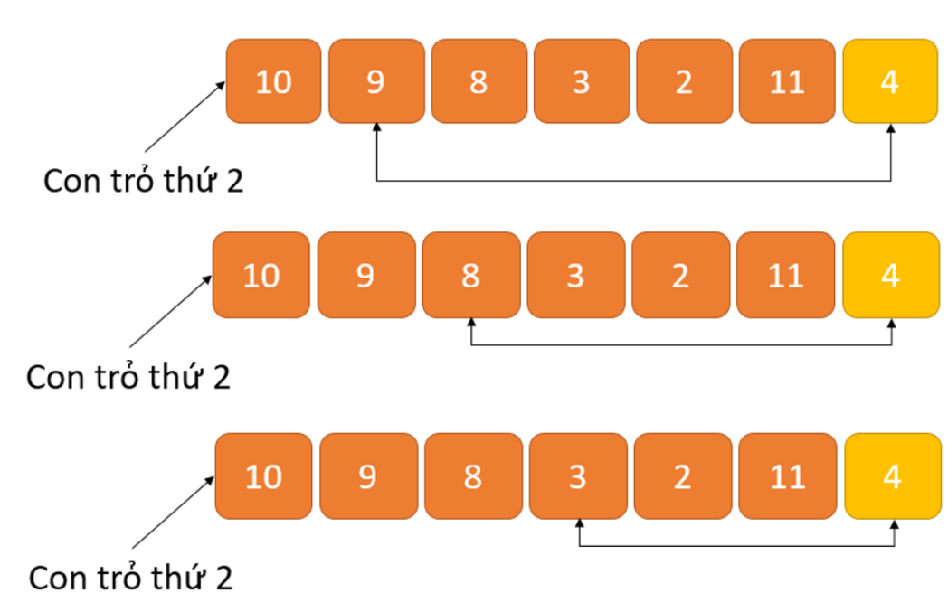
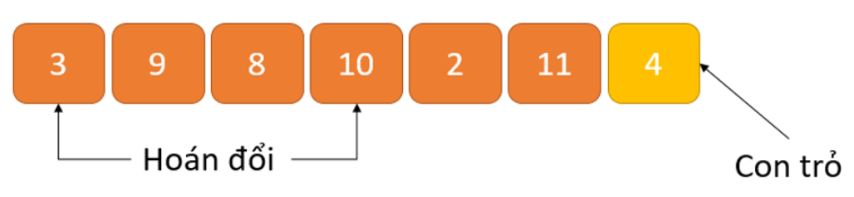
How the QuickSort algorithm works
HOANG
Step 1: An element named Pivot is selected from the array. We can select any element in the array as this element. Here, we have used the rightmost element (i.e. last element) of the array as the Pivot element.
Step 2: Elements smaller than Pivot element will be placed on the left and elements larger than Pivot element will be placed on the right.
The arrangement is as follows:
A cursor is fixed at the Pivot element (4). The Pivot element is compared with other elements starting at the first index. If an element greater than the Pivot element is reached, a second pointer is set to that element.
Now, the Pivot element is compared with other elements (the third pointer). If an element smaller than the Pivot element is reached, the smaller element is swapped with the larger element found earlier.
Notes:
Bước 1: Một phần tử có tên là Pivot được chọn từ mảng. Ta có thể chọn bất kỳ phần tử nào trong mảng làm phần tử này. Ở đây, chúng ta đã sử dụng phần tử nằm ngoài cùng ở bên phải (tức là phần tử cuối cùng) của mảng làm phần tử Pivot.
Bước 2: Các phần tử nhỏ hơn phần tử Pivot sẽ được đặt ở bên trái và các phần tử lớn hơn phần tử Pivot được đặt ở bên phải.
Cách sắp xếp như sau:
Một con trỏ được cố định tại phần tử Pivot (4). Phần tử Pivot được so sánh với các phần tử khác bắt đầu từ chỉ số đầu tiên. Nếu đạt đến phần tử lớn hơn phần tử Pivot, con trỏ thứ hai được đặt cho phần tử đó.
Bây giờ, phần tử Pivot được so sánh với các phần tử khác (con trỏ thứ ba). Nếu đạt đến phần tử nhỏ hơn phần tử Pivot, phần tử nhỏ hơn sẽ được hoán đổi với phần tử lớn hơn được tìm thấy trước đó.
Quá trình tiếp tục cho đến khi đạt được phần tử cuối cùng thứ hai.
Cuối cùng, phần tử pivot được hoán đổi với con trỏ thứ hai.

Slide 19
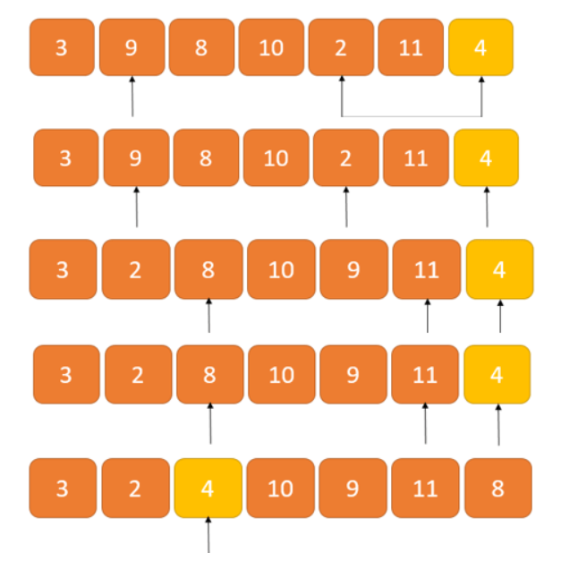
HOANG
How the QuickSort algorithm works
The process continues until the second last element is reached.
Finally, the pivot element is swapped with the second pointer
Notes:
Sau khi xong rồi thì chúng ta nhận thấy số 4 là phần tử trung tâm, hay còn gọi là trục trung tâm. Lúc này, ta sử dụng đệ quy để sắp xếp các phần con

Slide 20

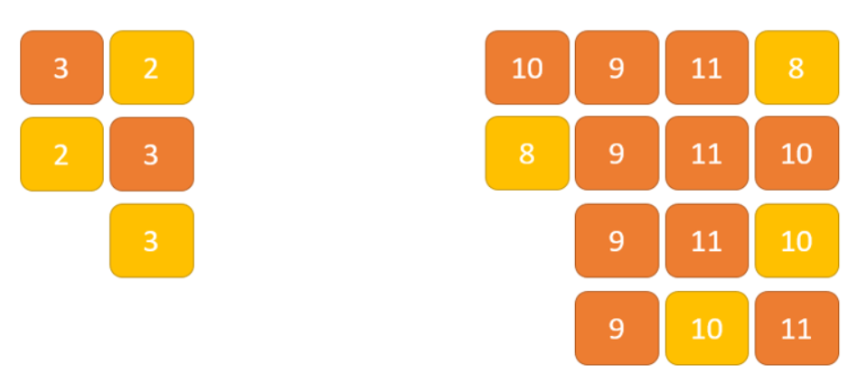

HOANG
Step 1
How the QuickSort algorithm works
Left array
Right array
1. Divide step
The array is divided into subsections and takes the Pivot element as the split point. Elements smaller than the Pivot are placed on its left and larger elements are placed on the right.
2. Conquer step
The left and right subsections are again divided by selecting Pivot elements for them. This can be achieved by recursively passing subsections into the algorithm.
3. Merging step
This step does not play an important role in this Quicksort algorithm. The array is sorted at the end of the Conquer step.
Step 2
Step 3

Slide 21
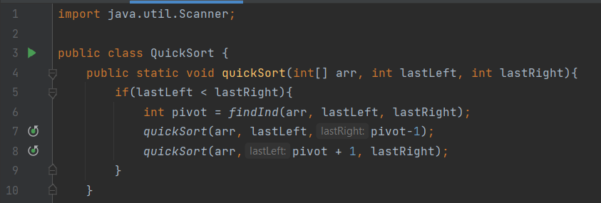
HOANG
DEMO CODE
Algorithm idea
If last element on the left < last element on the right
Perform assignment of Pivot element index -> division function(array, last left index, last right index)
QuickSort function(array, last left index, Pivot element index)
QuickSort function(array, Pivot element index + 1, last right index)
Notes:
Ý tưởng thuật toán
Nếu phần tử cuối cùng bên trái < phần tử cuối cùng bên phải
Thực hiện gán cho chỉ số của phần tử Pivot <- hàm phân chia(mảng,chỉ số bên trái cuối cùng, chỉ số bên phải cuối cùng)
Hàm QuickSort(mảng, chỉ số bên trái cuối cùng, chỉ số của phần tử Pivot)
Hàm QuickSort(mảng, chỉ số của phần tử Pivot + 1, chỉ số bên phải cuối cùng)
Ta có thêm 1 hàm tìm vị trí gồm có(Mảng, phần tử cuối cùng bên trái , phần tử cuối cùng bên phải)
….

Slide 22
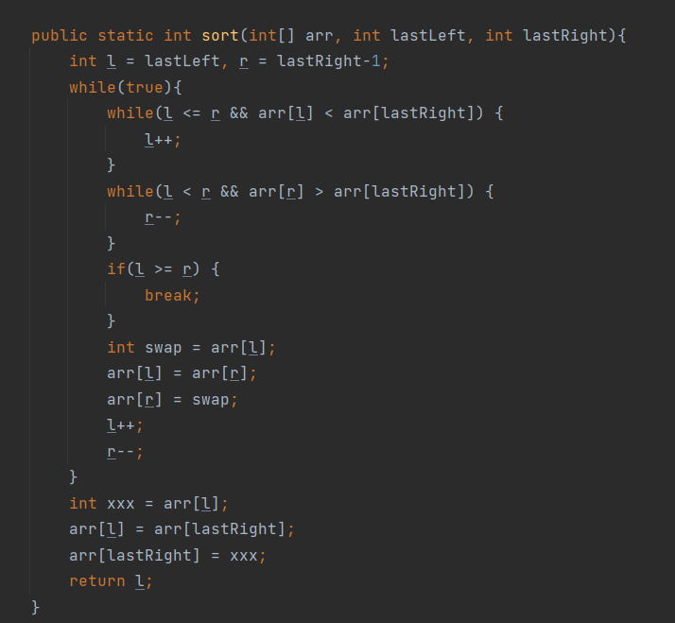
HOANG
DEMO CODE
We have 1 more sort function including (Array, last element on the left, last element on the right)
and we assign variable named l = lastLeft and variable r = lastRight – 1
We'll implement them in the while loop:
When l <= r and array contains element l < array contains lastRight, then l++
Conversely, when l < r and array contains r > array contains lastRight then r--
If l >= r, then stop, break and we give a new variable called swap and assign it with arr[l]
arr[l] = arr[r], arr[r] = swap while l increases and r decreases End of while loop
Outside the while loop, we give a new variable called xxx and assign it = arr[l]
arr[l] will be equal to arr containing the last elements on the right these elements are again equal to the variable xxx, then return l
Notes:
Ta có thêm 1 hàm sort gồm có (Mảng, phần tử cuối cùng bên trái , phần tử cuối cùng bên phải)
và ta thực hiện gán biến tên là l = lastLeft và biến r = lastRight - 1
Chúng ta sẽ triển khai chúng trong vòng lặp while:
Khi l <= r và mảng chứa phần tử l < mảng chứa lastRight thì l++
Ngược lại, khi l < r và mảng chứa r > mảng chứa lastRight thì r--
Nếu mà l >= r rồi á thì dừng, break và ta cho 1 biến mới gọi là swap gán bằng arr[l]
arr[l] = arr[r], arr[r] = swap đồng thời l tăng và r giảm Kết thúc vòng lặp while
Ở bên ngoài vòng lặp while thì ta cho một biến mới gọi là xxx và gán nó = arr[l]
arr[l] này sẽ bằng arr chứa các phần tử cuối cùng bên phải
những phần tử này lại bằng biến xxx, sau đó trả về l

Slide 23
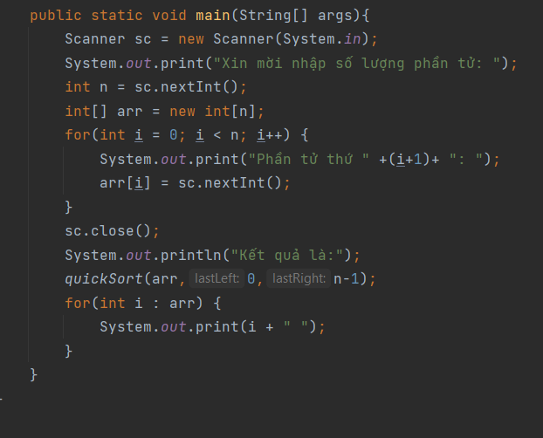
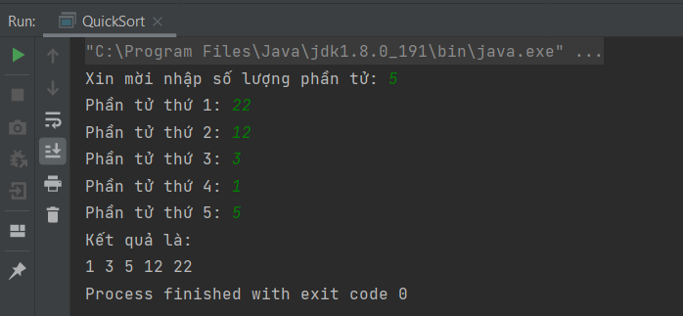
HOANG
DEMO CODE
Result after entering 5 random elements and running the program:
Input: 22, 12, 3, 1, 5
Result: 1, 3, 5, 12, 22

Slide 24
Complexity Of Quick Sort
HOANG
For an array, where partitioning leads to unbalanced sub-arrays, like the example I mentioned above, the left sub-array has only 2 elements, and the right sub-array has 4 elements.
And if keep getting unbalanced subarrays, the runtime is worst case, which is O(n²)
When partitioning the sub-arrays is roughly equal, the runtime is best, with a time complexity of O(n * log n).
To sum it up
Worst case time complexity [Big-O]: O(n²)
Best case time complexity [Big-omega]: O(n * log n)
Average Time Complexity [Big-theta]: O(n * log n)
As we know now, if sub partition is created after unbalanced partition, quick sort will take longer time to complete. To avoid this, we can also choose the element to rotate randomly. It won't make any difference in the algorithm, as all we need to do is pick a random element from the array, swap it with the element at the last index, make it rotate round and continue with quick sort.
The required space of quick sort is very little, just extra space O(n * log n). Quick sort is not a stable sorting technique, so it can change the appearance of two identical elements in the list when sorting.

Slide 25

INSERT SORT
Hung
1
Definition
2
Code demo
3
Time complex
4
Growth function

Slide 26
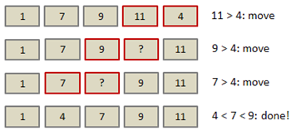
Hung
1. Definition
Insertion sort is a simple sorting algorithm that allows for efficient, in-place sorting of the array, one element at a time. By in-place sorting, we mean that the original array is modified and no temporary structures are needed.
Insertion sort is a sorting algorithm that places an unsorted element at its suitable place in each iteration.
Insertion sort works similarly as we sort cards in our hands in a card game.

Slide 27
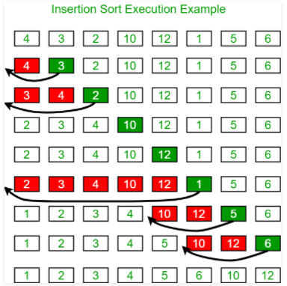
Hung
2. How insert sort work?
- To sort an array of size n in ascending order:
1: Iterate from arr[1] to arr[n] over the array.
2: Compare the current element (key) to its predecessor.
3: If the key element is smaller than its predecessor, compare it to the elements before. Move the greater elements one position up to make space for the swapped element.

Slide 28
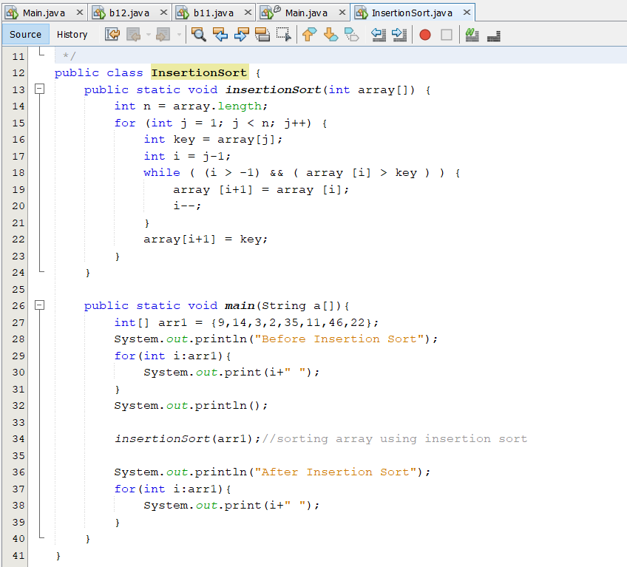
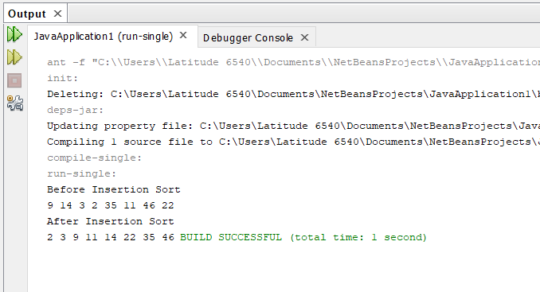
Hung
2. Code demo
- An insertion sort starts by considering the two first elements of the array data, which are data[0] and data[1]
- Next, the third element, data[2], is considered and inserted into its proper place (ascending)
- Its complexity is O(n2) and best case is O(n)

Slide 29
Hung
3. Time complex
- Worst Case Complexity: O(n2)
+ Suppose, an array is in ascending order, and you want to sort it in descending order. In this case, worst case complexity occurs.
+ Each element has to be compared with each of the other elements so, for every nth element, (n-1) number of comparisons are made.
- Best Case Complexity: O(n)
+ When the array is already sorted, the outer loop runs for n number of times whereas the inner loop does not run at all. + So, there are only n number of comparisons. Thus, complexity is linear.
- Average Case Complexity: O(n2)
+ It occurs when the elements of an array are in jumbled order (neither ascending nor descending).
- Space Complexity
+ Space complexity is O(1) because an extra variable key is used.
Best | O(n)
Worst | O(n²)
Average | O(n²)
Space Complexity | O(1)
Stability | Yes

Slide 30




Thank you!
facebook.com/hoang.nguyenhuu.7330763/
036 8716 708
hoangnhbdaf190022@fpt.edu.vn

